Slide 1
Mobile Application Development
Android Studio Installation

Slide 2
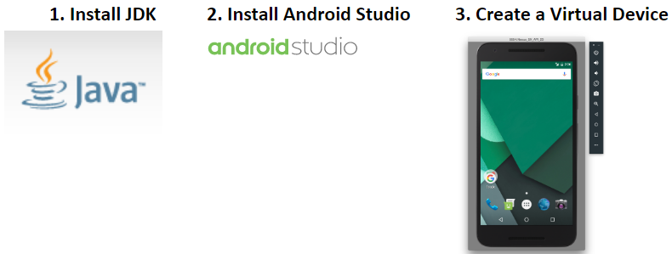
Installing Android Studio
In order to develop Android apps, you will need to install two Products:
Oracle Java Development Kit ("JDK")
The Android Studio editor.
Its Basically a three step process

Slide 3
1. Install Oracle Java Development Kit (JDK)
Since Android apps are written in Java, you will need the Oracle Java compiler and libraries on your system.
These are collectively called the Java Development Kit or "JDK" for short.
If you are certain that you already have JDK 1.8 or higher on your computer, you can skip this Step.

Slide 4
1. Install Oracle Java Development Kit (JDK)
Download the JDK from the following address:
http://www.oracle.com/technetwork/java/javase/downloads/
x86 are 32 bit operation system
x64 are 64 bit operation system
Be careful to choose "JDK" and not "JRE".
JRE enables you to run Java programs but not compile or develop your own.
install JDK on your system using default settings.

Slide 5
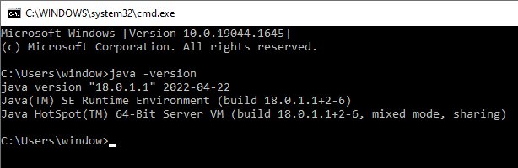
1. JDK Installation
If you want to check that JDK is installed successfully on your PC.
Open command prompt and type following command
c:\user\window\ java –version

Slide 6
Step 2. Download and Install Android Studio IDE
The next piece of software for you to install is called Android Studio.
Android Studio is an official text editor and integrated development environment (IDE) for developing Android apps.
You must install Oracle JDK before installing Android Studio,
so don't start this step until you have completed Step 1.

Slide 7
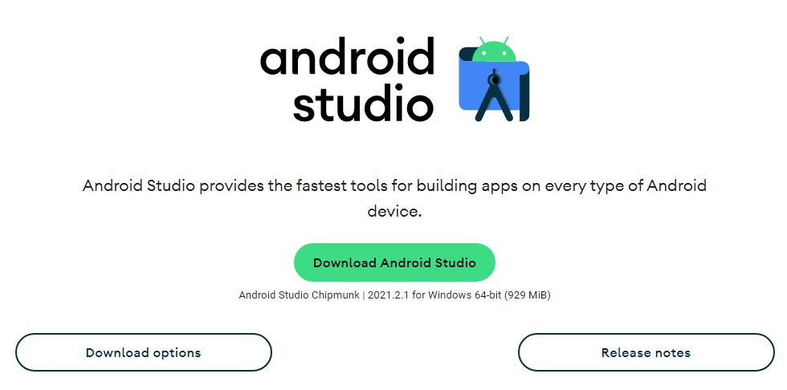
Step 2. Download Android Studio IDE
Download Android Studio from the following address:
https://developer.android.com/studio
If you want to download an older version that is compatible for your PC
https://developer.android.com/studio/archive

Slide 8
Step 2.1. Install Android Studio IDE
Once you have downloaded the installer,
Run it to install Android Studio on your computer.
Make sure that the "Virtual Device" checkbox is checked during your install.
You can choose all of the default settings during the installation.
The installation make take a while because of all the components and libraries included.
The Drive for installation should contain approximately 20GB of free space.

Slide 9
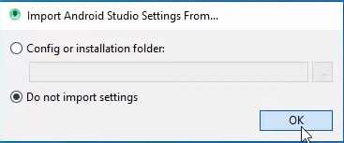
Step 2. Install Android Studio IDE
On its First run android studio will ask for import settings.
Select Do not import settings and click OK

Slide 10
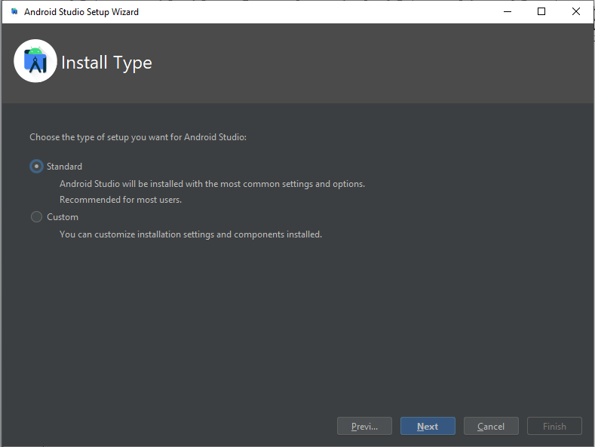
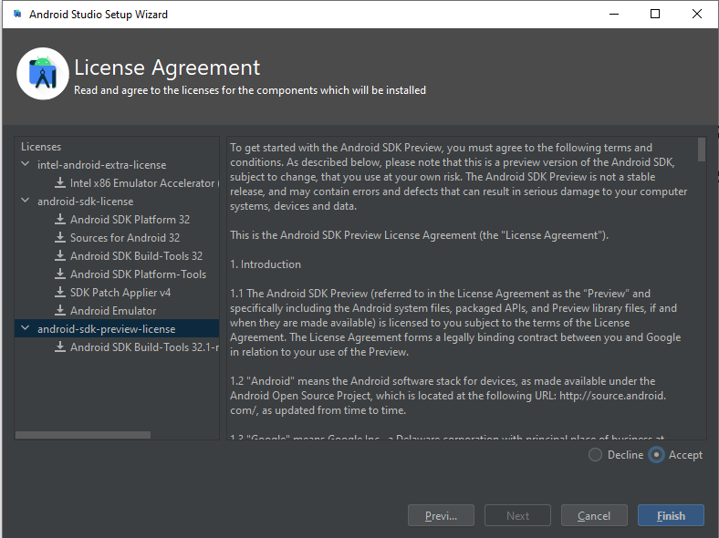
Step 2.2. Android Studio Setup Wizard
The setup wizard will ask few questions.
Press Don’t Send for google user statistics.
Choose Installation Type as Standatd and Press Next
Verify Settings on Next Screen and Press Next
Read and Accept the License Agreements.
Click Finish.

Slide 11
Step 2. Install Android Studio IDE
When you first run Android Studio, there are further questions and downloads of various components.
You may again use all of the defaults for this part of the process.

Slide 12
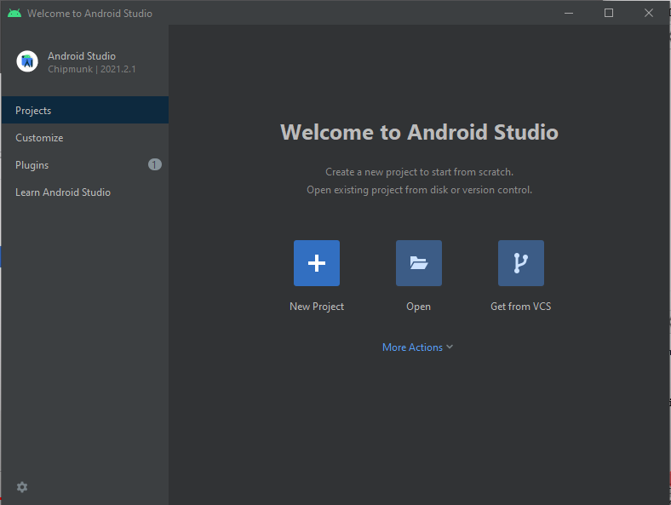
Welcome to Android Studio
After Successful installation a welcome screen will appear.
On the First screen Click New Project

Slide 13
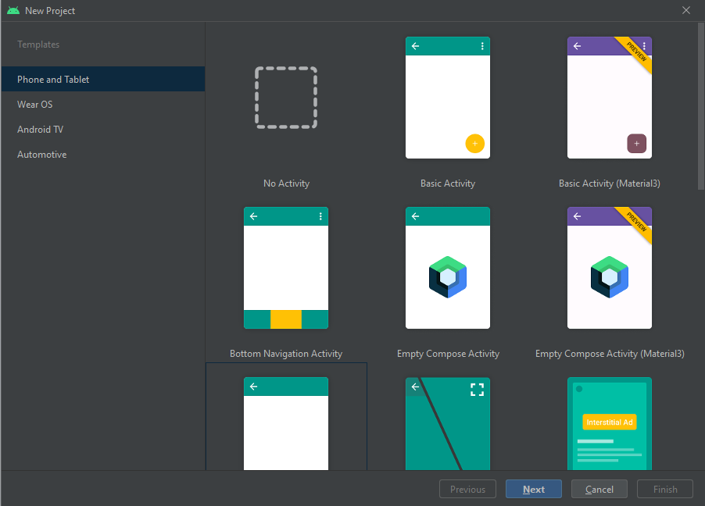
New Project
There are various templates available for
Phone, Tablet and TV etc.
Select a template for you project.
As a beginner select empty activity.

Slide 14
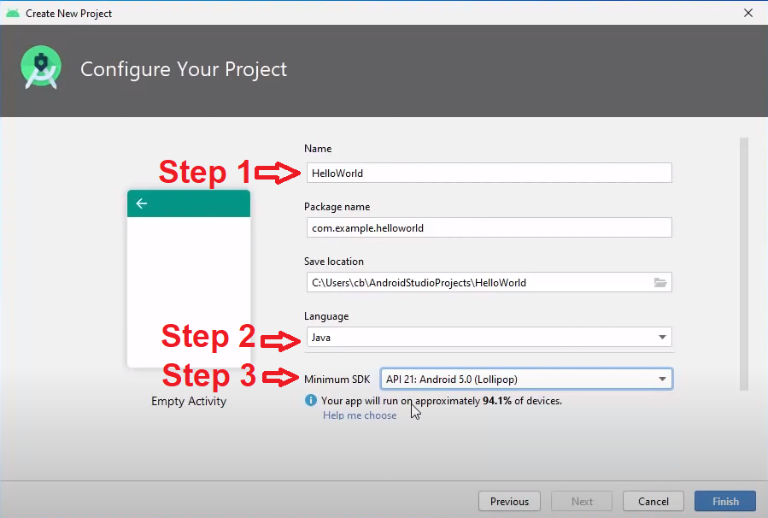
Configure Your Project
Step 1: Type Name of the Project like “HelloWorld”
Step 2: Select the Language as “JAVA” instead of Kotlin.
Step 3: Choose Minimum SDK.
When you press finish wait for the Gradle to finish sync.

Slide 15
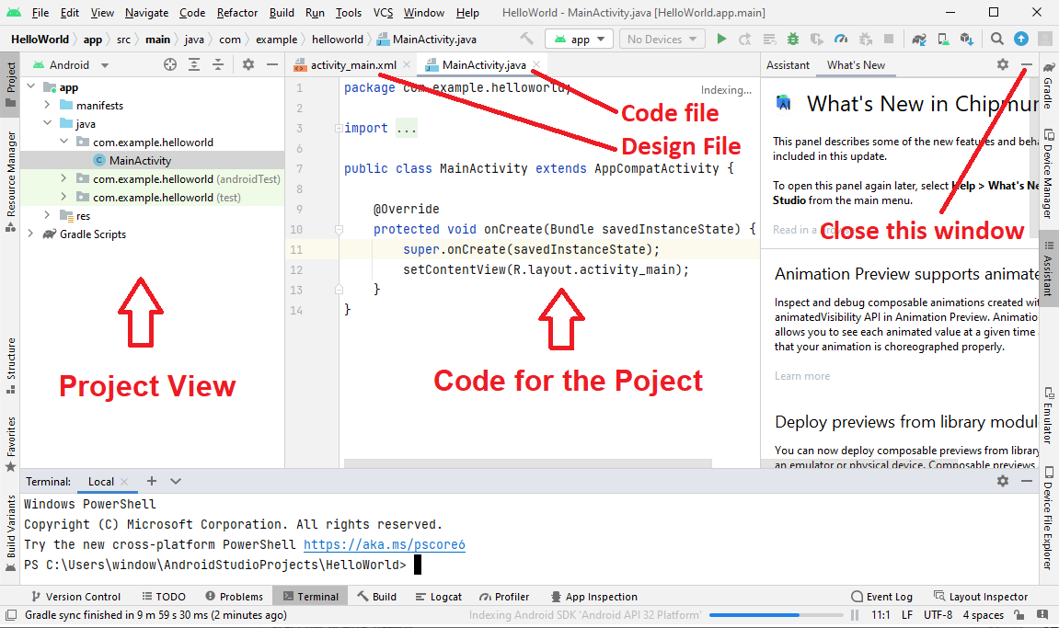
The Project main screen
When the Gradle finished sync the following window appears.

Slide 16
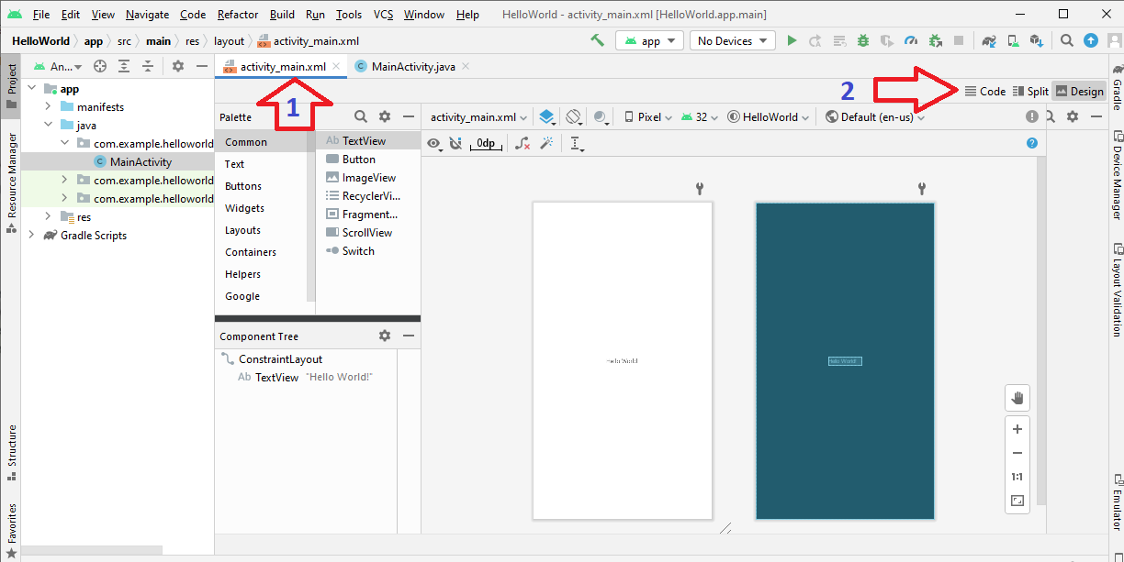
The Activity_main
The Blow interface appears when we click on activity_main.xml file.
You can select different interface Code, split and design

Slide 17
Step 3
Create Virtual Device

Slide 18
Create Virtual Device
An Android Virtual Device (AVD) is a configuration that defines the characteristics of an
Android phone,
Android Tablet,
Android TV, or
Automotive OS device
that you want to simulate in the Android Emulator.
The Device Manager is an interface you can launch from Android Studio that helps you create and manage AVDs.

Slide 19
Testing the Application
To Test your application,
There are two options to connect a device with android studio using device manage.
Virtual ( A virtual Anroid application to test application )
Physical ( You can test application on your smartphone )
Pair using USB
Pair Using Wifi

Slide 20
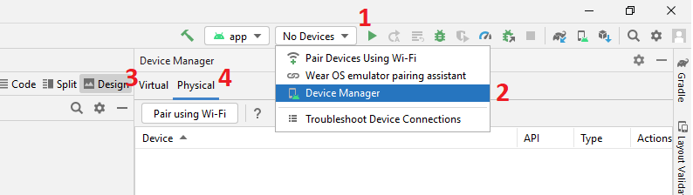
Testing the Application
1: Click on No Device as shown in below image.
2: Select Device Manager.
3: Help Configuration of Virtual Hardware.
4: Help configure Physical Hardware using (USB or Wifi).

Slide 21
Virtual Device Configuration

Slide 22
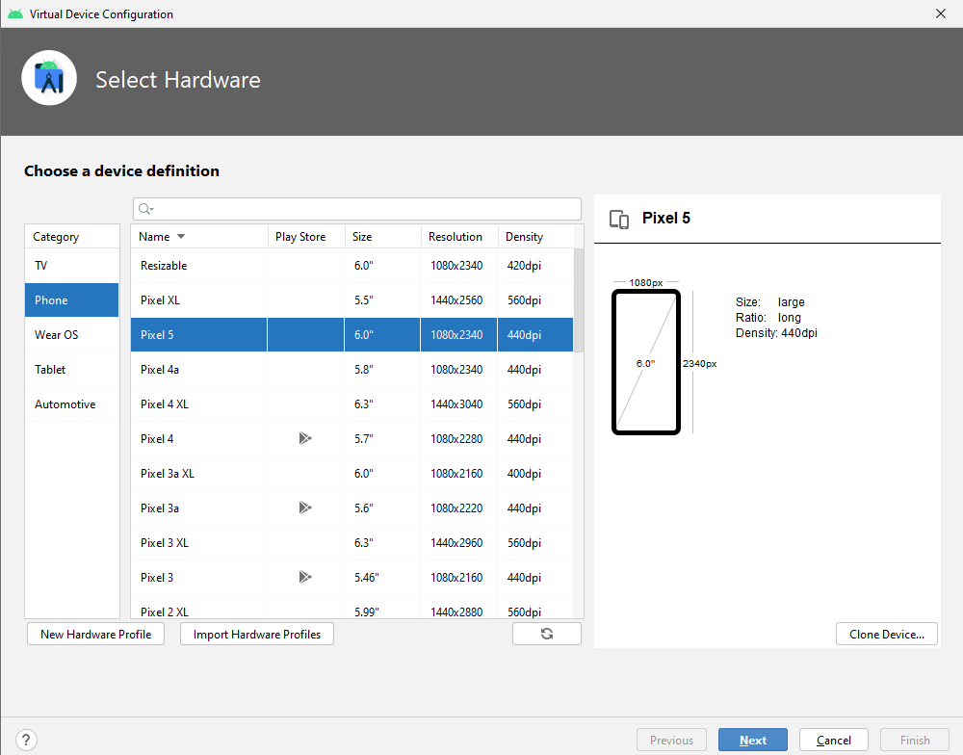
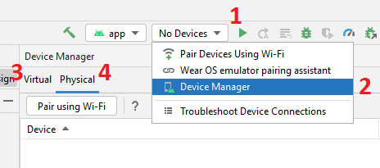
Select Virtual Hardware
Select Android Device category and Name for which the application is to be designed.
Perform Step 1, 2, 3 and Click Create Device.
Choose Category.
Choose Mobile.
Click Next.

Slide 23
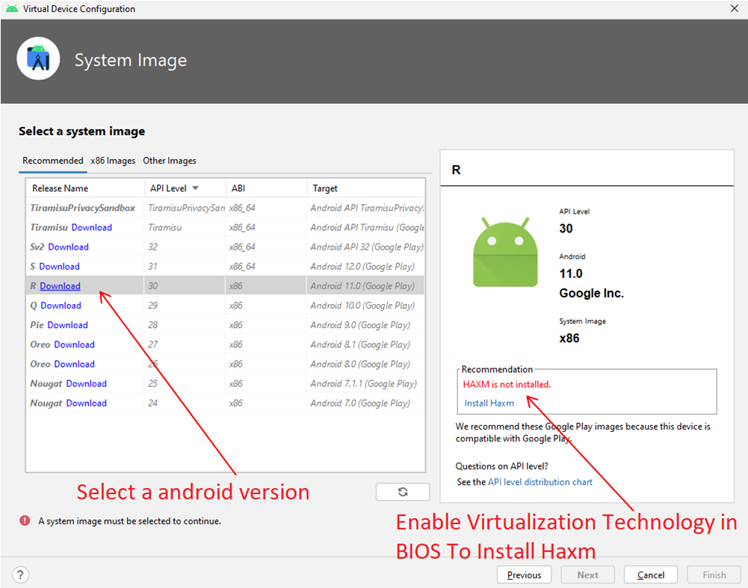
Install System Image
Download an Image of the Android version to install on selected device.
Haxm installation
process is on
next slide.

Slide 24
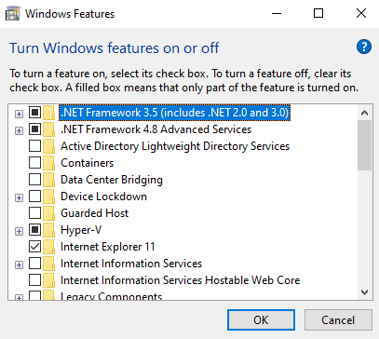
Install Haxm
In order to Install HAXM
Step 1 : Enable Virtualization from system BIOS
Step 2 : Turn on Hyper-V
To Turn Hyper-V on , Go to Start Menu and Type “Turn Windows Features on and off”.
In Next Window
Tick the Hyper-V Box
Press OK
If you are unable to configure
Haxm then you can use
USB or Wifi Pairing.

Slide 25
Pairing A Physical Device Pairing using USB Pairing using Wifi

Slide 26
Enable Developer Mode
To let Android Studio communicate with your Android device for both USB or Wifi Paring.
Frist Enable USB debugging in the Developer options settings of the android device( Mobile ).
Method to Enable USB debugging:
On your Android device/phone,
tap Settings > About phone.
Then “Tap Build number” seven times.
If prompted, enter your device password or pin.
Enabling Developer Mode is succeeded when you see a message “You are now a developer!”.

Slide 27
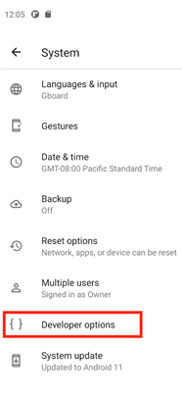
Pairing Using USB or Wifi
In order to turn on USB or Wifi pairing.
Return to Settings and then tap System > Developer options.
If you don't see Developer options, then
tap system > Advanced options > Developer options.
You will find option for both USB and Wifi

Slide 28
Pairing Using USB
Turn On Developer options and then tap the USB debugging toggle to turn it on.
On Windows, you must install a USB device driver before you can run your app on a physical device.

Slide 29
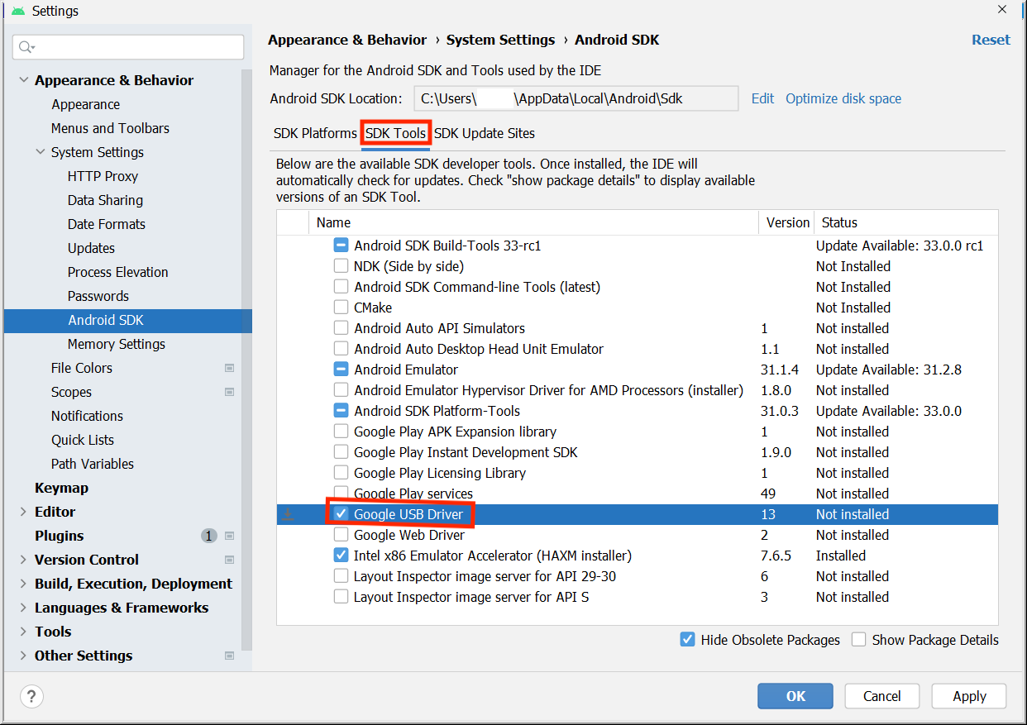
Pairing Using USB
In Android Studio, click Tools > SDK Manager.
The Preferences for New Projects dialog opens.
Click the SDK Tools tab. Select Google USB Driver and then click OK.

Slide 30
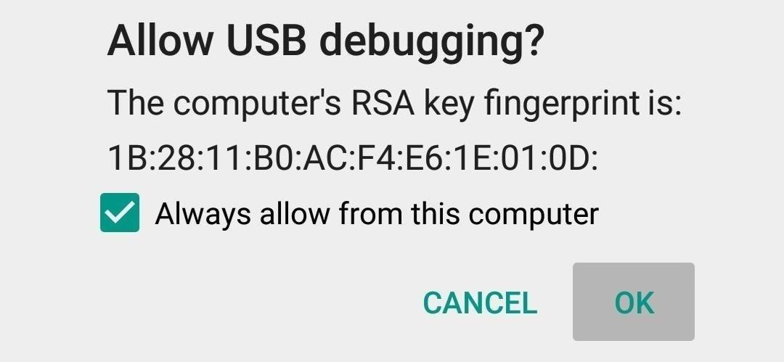
Pairing Using USB
Connect your Android device to your computer with a USB cable.
A dialog should appear on your device, which asks you to allow USB debugging.
Select the Always allow from this computer checkbox and then tap OK.

Slide 31
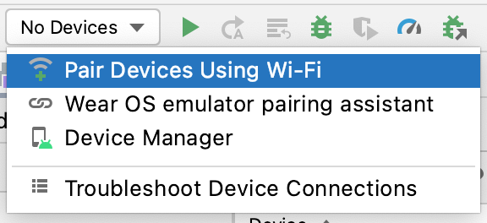
Pairing Using Wifi
In order to Pair using Wifi
Ensure that your computer and device are connected to the same wireless network.
Ensure that your device runs Android 11 or higher.
Ensure that your computer has the latest version of Android Studio.
Ensure that your computer has the latest version of the SDK Platform Tools.
Click Pair Devices Using Wifi.

Slide 32
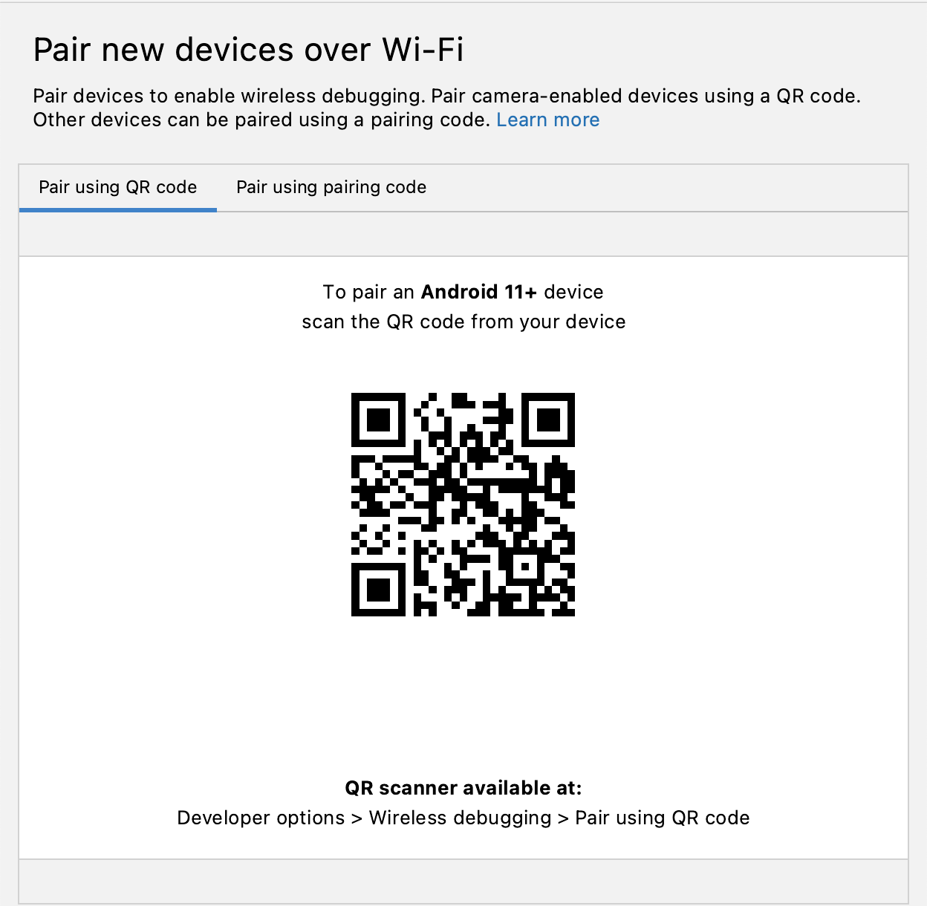
Pairing Using Wifi
The Pair devices over Wi-Fi dialog opens.

Slide 33
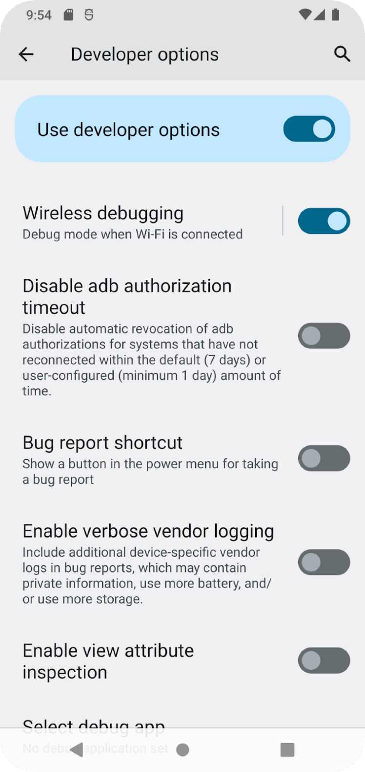
Pairing Using Wifi
On your mobile Phone ,
Go to Developer Options
and turn on Wireless debugging.
You can connect using two options
1. Using QR Code
2. Using Pairing Code

